Slide 1
Microsoft Purview Data Loss Prevention

Slide 2
Agenda
Introduction to Data Loss Prevention (DLP)
Introduction to Microsoft Purview Data Loss Prevention
Implementation of Data Loss Prevention policy
Use Cases of Data Loss Prevention
Limitations
Questions - Please raise your hand or type in the chat if you have any questions

Slide 3

What is Data Loss Prevention (DLP)
A strategy for ensuring end users do not send sensitive or critical information outside the corporate network.

Slide 4
Data Breach Statistics
“60% to 70% of all data breaches warrant public disclosure." [Source: Intel]
"Average cost of a data breach: $4.45 million in 2023."
[IBM Security and Ponemon Institute]
"30% of data breaches involved internal actors."
[Verizon's Data Breach Investigations Report]
"21% of cloud-based files contain sensitive data."
[McAfee Cloud Adoption and Risk Report]

Slide 5

Implementation of Canadian Driver License Data Loss Prevention policy

Slide 6
1. Assessment & Planning
Identify sensitive information types you need to monitor (e.g., Drivers License, Social Security Numbers, credit card numbers).
Determine the sources of data (e.g., SharePoint, Exchange, Teams).

Slide 7
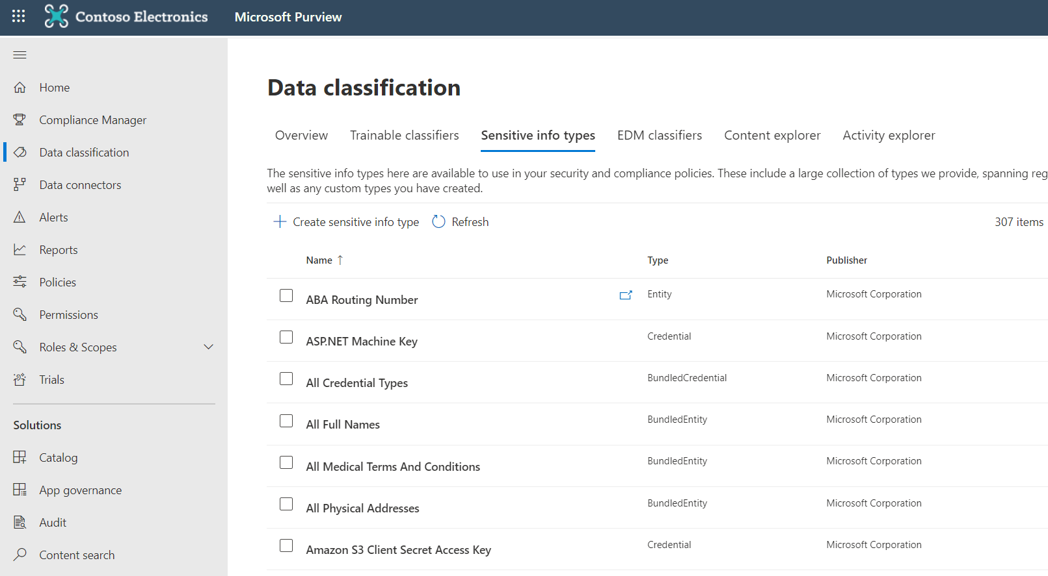
2. Configuration & Setup:
Navigate to the Microsoft Purview Center.
Define Sensitive info type to be used in the policy.

Slide 8
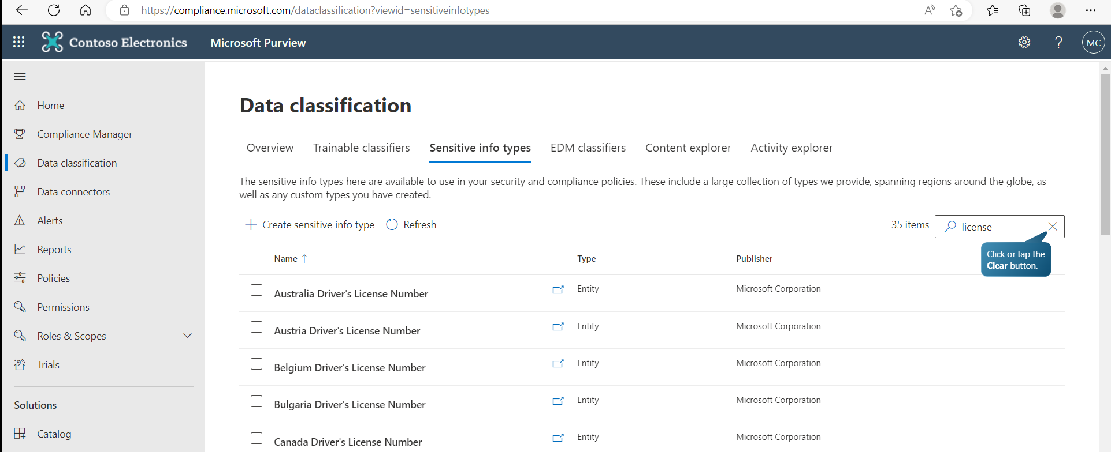
Search for sensitive info type. Note you can create custom ones. In our case we will search for license and discover and inbuilt Canadian Driver’s License Number.

Slide 9
3. Policy Creation:
Use built-in templates or create custom policies to define what constitutes sensitive information and what actions to take when such data is detected.

Slide 10
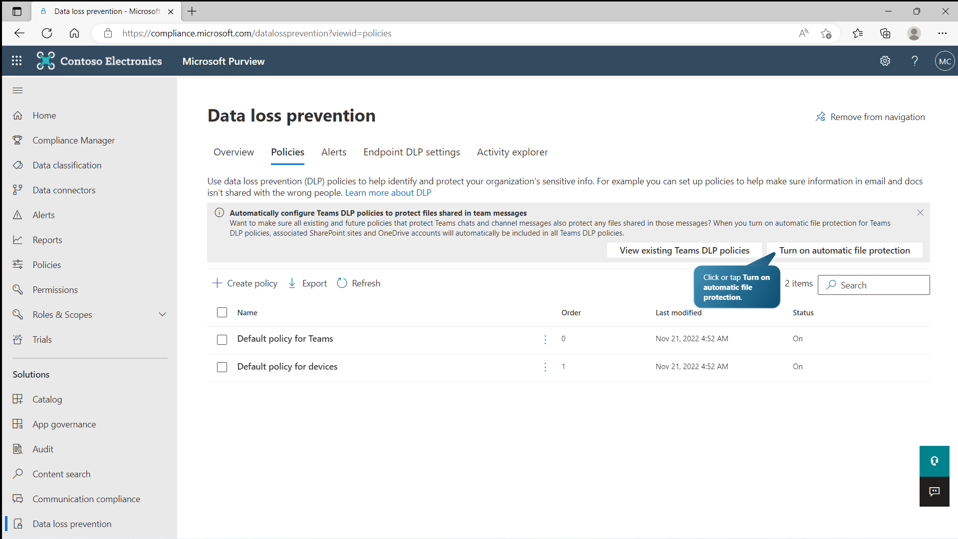

Slide 11
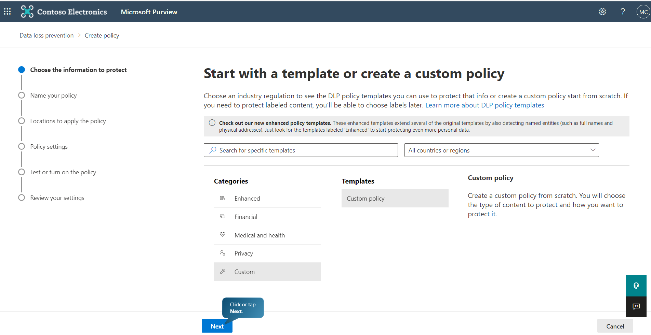

Slide 12
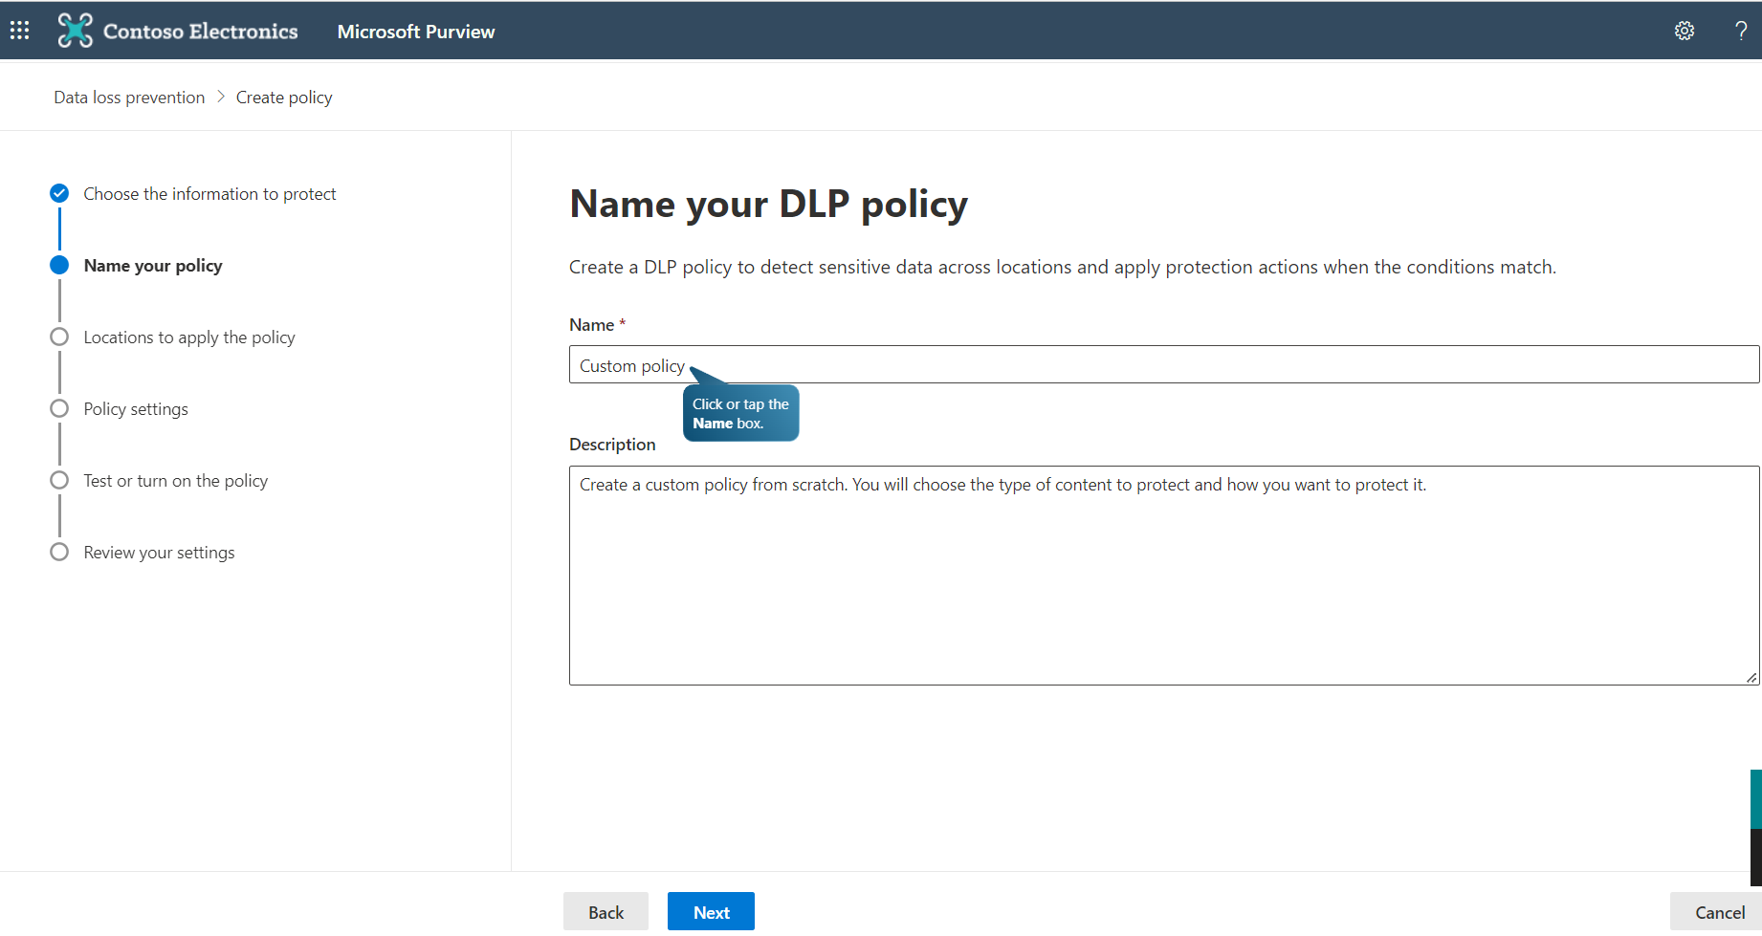
Provide Policy Name and a description of what it does

Slide 13
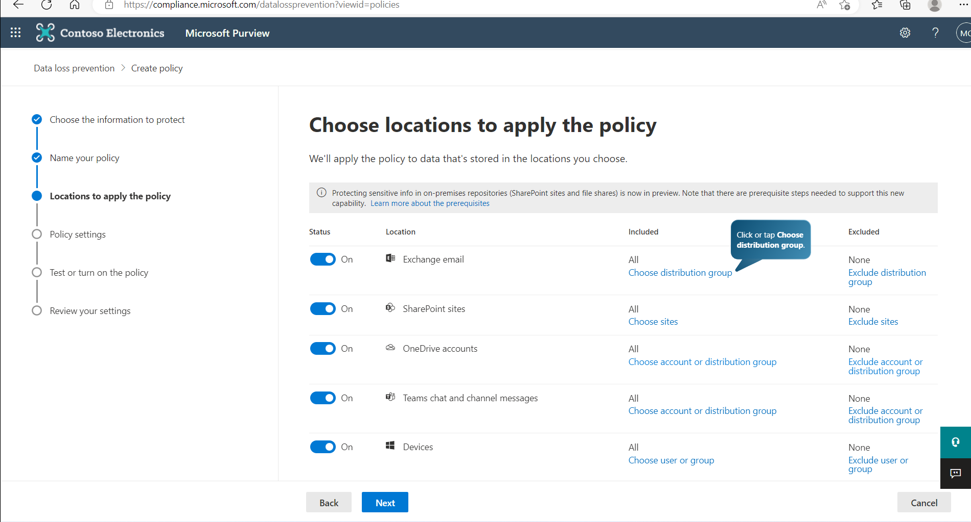
Define the locations where the policy applies

Slide 14
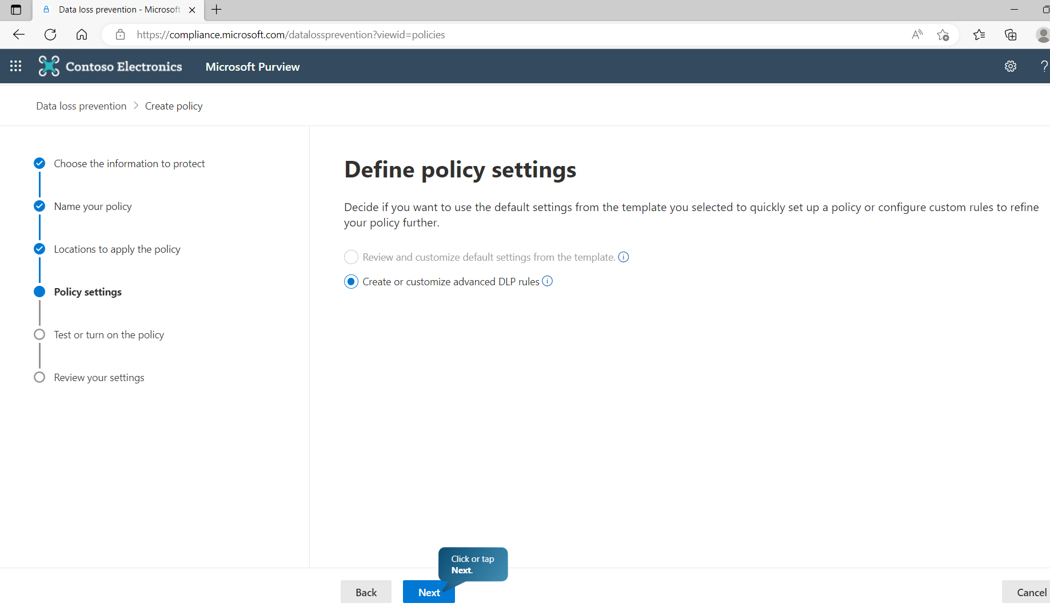
Define the advanced DLP rules

Slide 15
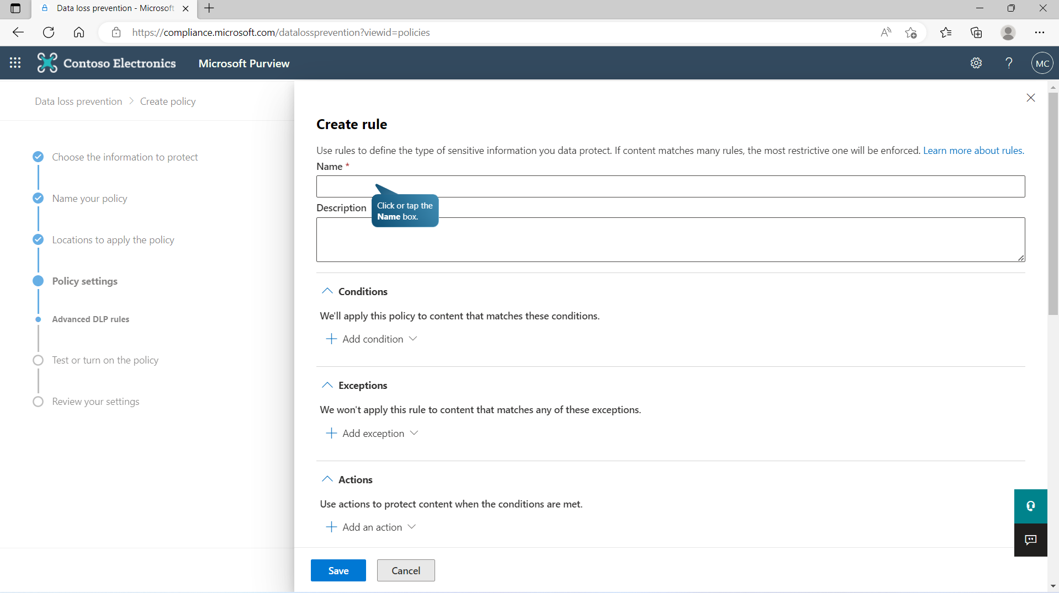
Create the Rule (See our advanced class for a guide).

Slide 16
Name – Canadian Drivers License
Description – Prevent release of Canadian DL #
Contains inbuilt "Canadian Drivers License“ sensitive info type
Content is shared from Microsoft 365
Exceptions - Add HR Group,
Actions - Encrypt content in Microsoft 365 locations
Restrict Access - Block people outside organization
Send an email alert to administrator on policy match

Slide 17
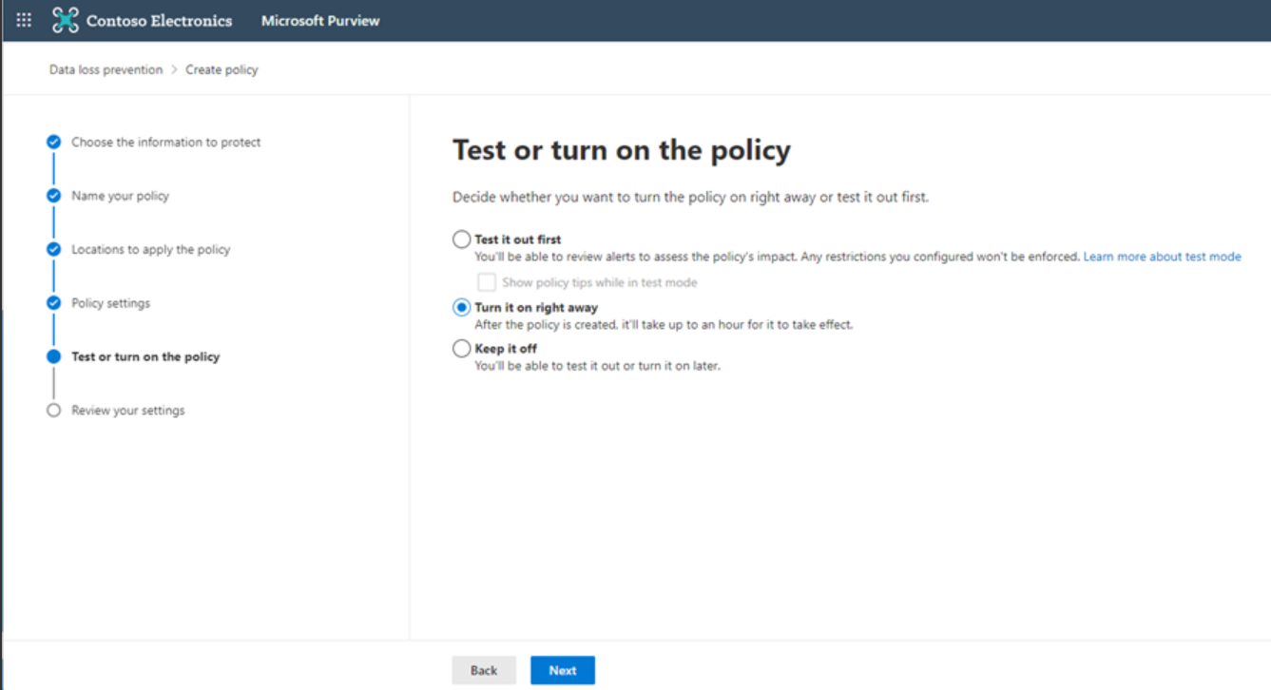
4. Policy Testing:
Run policies in "Test" mode to observe potential impacts without actually interfering with users' activities.

Slide 18
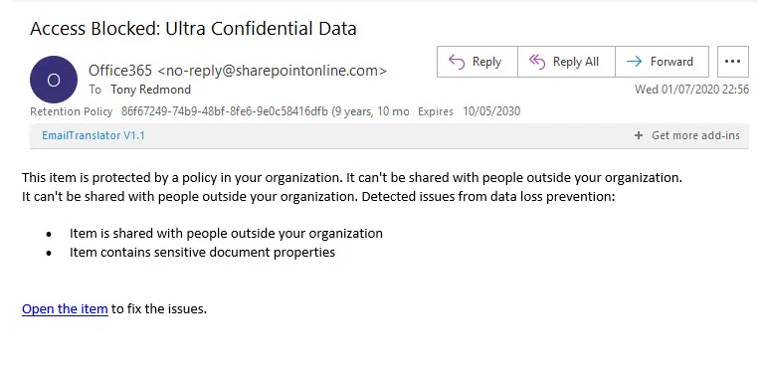
5. Deployment:
After reviewing tests and the impact on business, make the policy active. Email Blocked Notification:

Slide 19
6. Monitoring & Reporting:
Utilize built-in dashboards and reports to monitor activities and incidents.
Adjust policies based on false positives/negatives and other feedback.

Slide 20
7. Regular Review & Update:
As business needs change and new data types emerge, periodically review and adjust your DLP policies.

Slide 21
8. User Education:
Inform and train end-users about the importance of DLP, how it works, and what to expect in terms of notifications or restrictions.

Slide 22
Benefits: Use Cases for DLP
Preventing confidential document uploads to personal cloud storage accounts.
Stopping sensitive information transmission via unencrypted email channels.
Alerting on unauthorized access attempts to classified data repositories.
Monitoring chats for inadvertent sharing of proprietary project details.

Slide 23
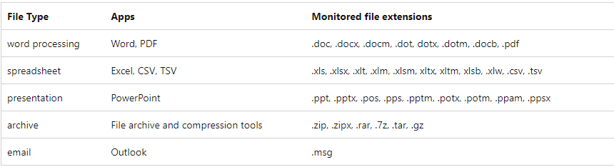
Limitations: File Type Supported

Slide 24
Limitations: License Restrictions
Microsoft 365 E5
Microsoft 365 A5 (EDU)
Microsoft 365 E5 compliance
Microsoft 365 A5 compliance
Microsoft 365 E5 information protection and governance
Microsoft 365 A5 information protection and governance

